Slide 1
Access Practices
ATLAS INNOVATION
Dr Emmanouela Patiniotaki

Slide 2
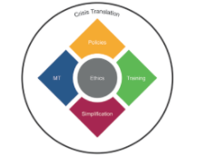
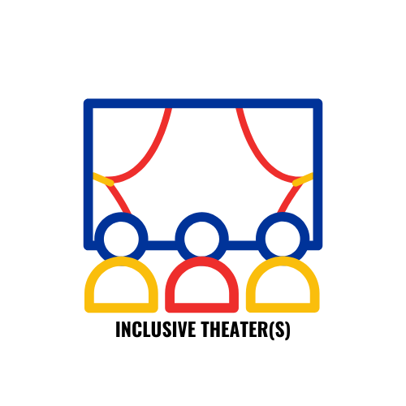
Involvement (development of INCLUDE framework)
Academic/Researcher in:
Accessibility
AVT
Assistive Technology
Language Automation
Crisis Translation
Translation Technology
Access Services Provider & Accessibility Production Expert Translation & Accessibility trainer
about me

Slide 3
Who are we?

Slide 5
SDH & CC

Slide 6
Subtitling & Surtitling

Slide 7
Voicing
Voice Over
Commentary
Audio Subtitling
Marketing

Slide 8
Audio Description & Tactile Tours

Slide 9
STTI – Speech to Text Interpreting

Slide 10
Accessibility Productions
Training for clients
Training for staff
Marketing and promotion
Accessibility chains
Financial management re accessibility
Consultation on architecture & content of various types

Slide 11
What we see in the content
Audiovisual material
Auditory non-verbal elements
Auditory verbal elements
Visual verbal elements
Visual non-verbal elements
©2023 Patiniotaki

Slide 12
An example of Live Subtitling

Slide 13
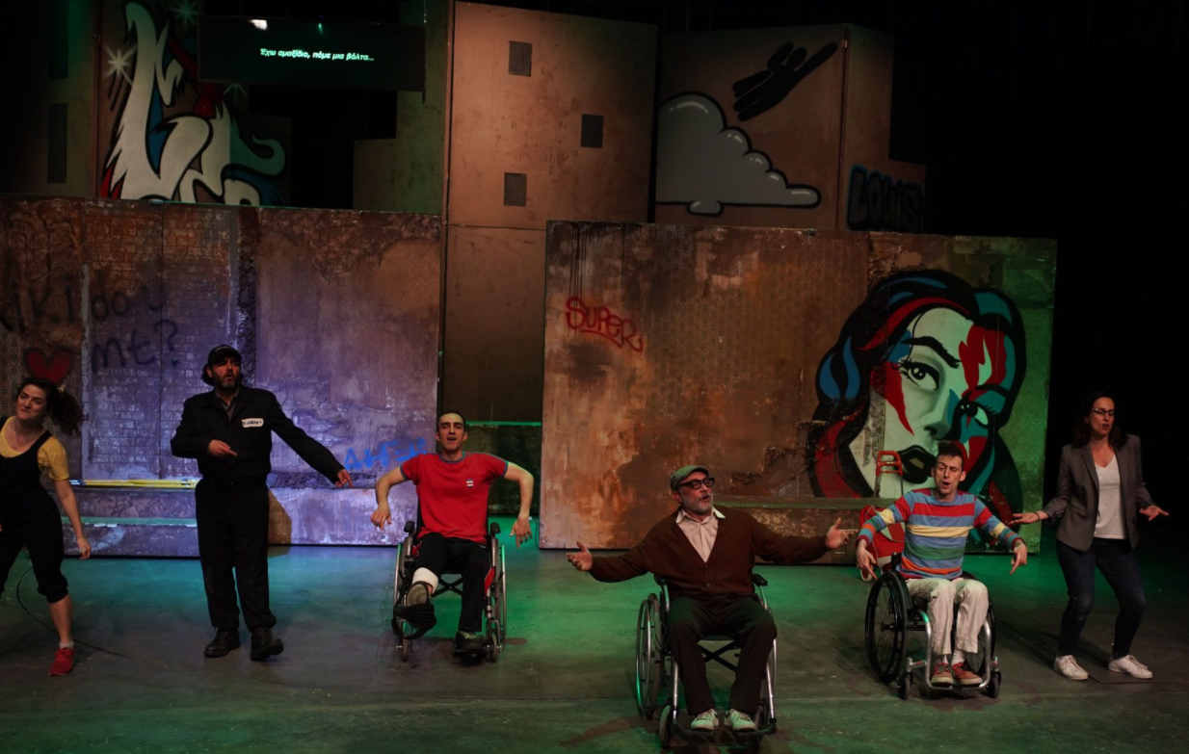
An example from Surtitling

Slide 14
Research & academic approach
Rights-based approach (Disabled Movement)
Towards a ‘politically and socially correct’ framework
Discussion: terminology, models (history & development), language (PFL & IFL), criticism, Disability Studies
Focus on the Social Model.
Social Model: disability is seen as barriers of inaccessibility set by society to those with an impairment
Oliver (1990a: 3): “It is not individual limitations, of whatever kind, which are the cause of the problem but society’s failure to provide appropriate services and adequately ensure the needs of disabled people are fully taken into account in its social organisation”.
©2023 Patiniotaki
Notes:
Example of audiovisual material:

Slide 15
On the social model of disability
Developed in the 1970s. It was “the big idea” of the British disability movement (Hasler, 1993).
It demonstrates that the problems disabled people face are the result of social oppression and exclusion, not their individual deficits.
There is no binary distinction between able and disabled. A person from one group may quickly become a member of the other through accident or illness. There is no absolute disability, there is only lack of access.

Slide 16
On the social model of disability
“The problem of disability is relocated from the individual, to the barriers and attitudes which disable her.”(ibid.)
Impairment is distinguished from disability. Impairment is individual and private.
Disability is structural and public. While doctors and professions allied to medicine seek to remedy impairment (cure the person), the real priority is to accept impairment and to remove disability (cure society).

Slide 17
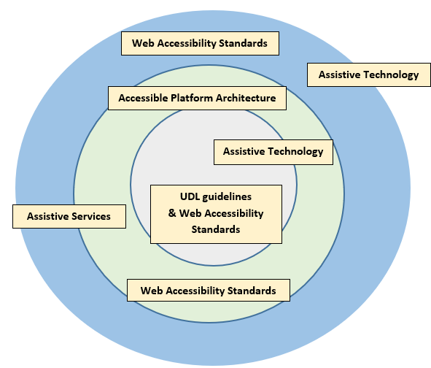
We apply the INCLUDE FRAMEWORK
©2021 Emmanouela Patiniotaki

Slide 18
An example of SDH from Greece

Slide 19
The approach is not simply functional…

Slide 20
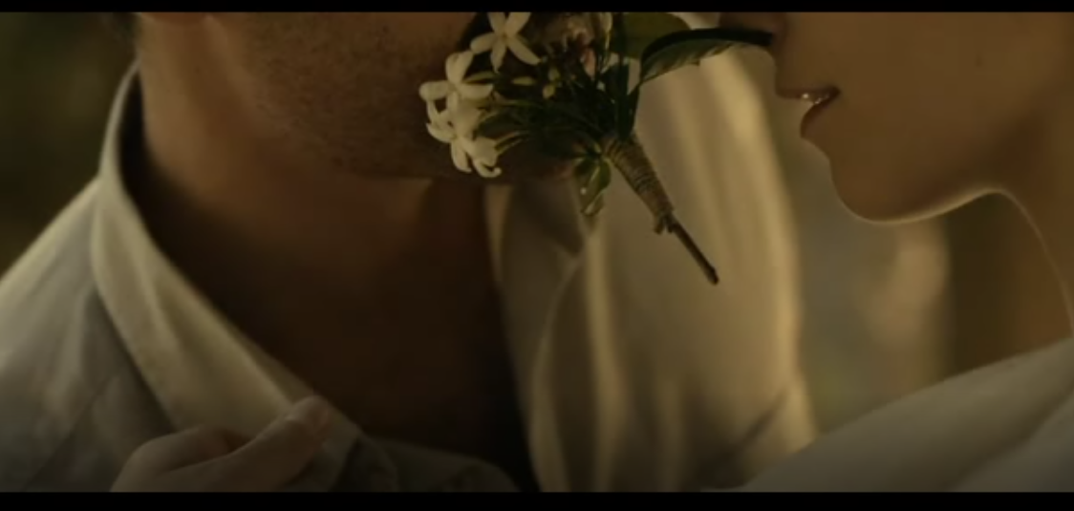
Little England - Accessible

Slide 21
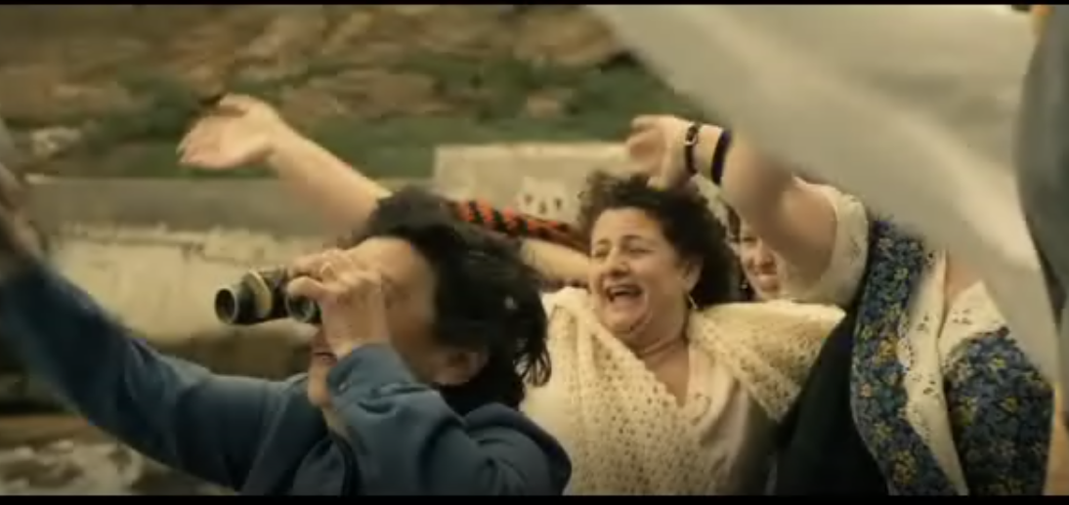

Slide 23
Various online sources

Slide 24
Various online sources

Slide 25
An example of AD from Greece

Slide 26
Dedicated software
Yella Umbrella Stellar
©2023 Patiniotaki

Slide 27
Our principles in Access Services… (e.g. SDH)
Excellent subtitling skills and deep knowledge of the technical aspects involved.
Excellent use of language.
Ability to prioritise information.
Ability to intergrade subtitles and make decisions on colouring, shaping and positioning.
Excellent management of the content pallet.
Basic knowledge of the means/context (e.g. cinema).
Knowledge of the combination of symbols, colours, characters in cases of total or partial colour blindness, knowledge of information receipt for the intended audience.
Excellent ability to match sounds with written discourse and the reality of the target audience.
Great sense of responsibility for the service they provide.
These are just to start with…

Slide 28
Our Research

Slide 29
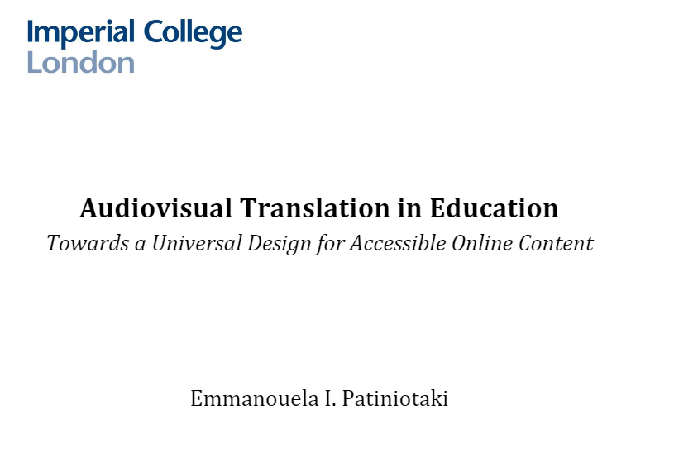
Further reading
https://www.researchgate.net/publication/350382846_Audiovisual_translation_in_education_towards_a_universal_design_for_accessible_online_content
©2023 Patiniotaki

Slide 30
For examples in Greek
www.atlas-ep.com

